Slide 1
Abnormality Detection and Localization in Chest X-Rays using Deep Convolutional Neural Networks
Kiwon Seo
2018. 11. 06

Slide 2
Abstract

Slide 3
Abstract
- Chest X-Rays (CXRs) are widely used for diagnosing abnormalities in the heart and lung area.
- Automatically detecting these abnormalities with high accuracy could greatly enhance real world
diagnosis processes
- In order to overcome these difﬁculties, we have used the publicly available Indiana chest X-Ray dataset,
JSRT data set and Shenzhen Data set and studied the performance of known deep convolutional network
(DCN) architectures on different abnormalities.

Slide 4
Abstract
- Our localization experiments using these trained classiﬁers show that for spatially spread out
abnormalities like cardiomegaly and pulmonary edema, the network can localize the abnormalities
successfully most of the time.
- We believe that through deep learning based classiﬁcation and localization, we will discover
many more interesting features in medical image diagnosis that are not considered traditionally.

Slide 5
Introduction

Slide 6
Introduction
- Medical X-rays are one of the ﬁrst choices for diagnosis due to its “ability is of revealing some
unsuspected pathologic alterations, its non-invasive characteristics, radiation dose and economic
considerations”
- X-Rays are mostly used as a preliminary diagnosis tool.

Slide 7
Introduction : CAD
- There are many beneﬁts of developing computer aided detection(CAD) tools for X Ray analysis.
- First of all, CAD tools help the radiologist to make a quantitative and well informed decision.
As the data is volume increases, it will become increasingly difﬁcult for the radiologists to go through
all the X-Rays that are taken maintaining the same level of efﬁciency.
- Automation and augmentation is severely needed to help radiologists maintain the quality of diagnosis.

Slide 8
Introduction : CAD
- However, the accuracy of these CAD tools has not achieved a signiﬁcantly high level to work
as independent inference tool. Thus CAD tools in X Ray analysis are left as mostly providing
easy visualization functionality.

Slide 9
Experiments

Slide 10
Experiments
- In a view to classifying abnormalities in the CXRs, a cascade of convolutional neural network (CNN)
and recurrent neural network(RNN) are employed on the Indiana dataset chest X-Rays
- Data set :
Indiana data set : Set consists of 7284 CXRs, both frontal and lateral images with disease annotations,
such as cardiomegaly, pulmonary edema, opacity or pleural effusion
(2) JSRT Dataset : Set compiled by the Japanese Society of Radiological Technology (JSRT).
The set contains 247 chest X-rays, among which 154 have lung nodules
(100 malignant cases, 54 benign cases), and 93 have no nodules.
(3) Shenzhen Dataset : This set is compiled at Shenzhen No.3 People’s Hospital, Guangdong Medical College,
Shenzhen, China. The recorded frontal CXRs are classiﬁed into two categories: normal and tuberculosis (TB).

Slide 11
Experiments : DCN
- Deep convolutional networks (DCN) have achieved signiﬁcantly higher accuracy than previous methods
In disease detection in various diagnostic modalities.
In many cases, these accuracies have surpassed human detection capabilities.
- We explored several DCN models, e.g, AlexNet, VGG-Net and ResNet.
These models vary in the number of convolution layers used and achieve higher classiﬁcation accuracy
as the number of convolution layers is increased.
Speciﬁcally, ResNet and its variants have achieved superhuman performance
on the celebrated ImageNet dataset.
- The features from the ResNet-50, ResNet-101 and ResNet-152 are extracted from the res4f, res4b22
and res4b 35 layers respectively.
All the DCN models have been implemented in Tensorﬂow and have been ﬁne tuned using Adam optimizer
with learning rate 0.001.

Slide 12
Results

Slide 13
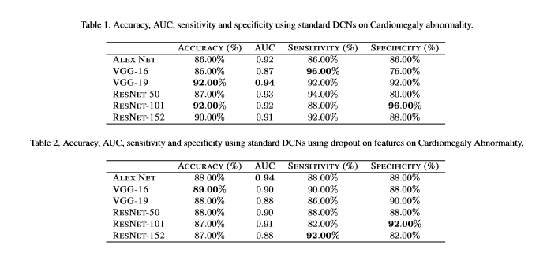
Results
-

Slide 14
Results
- We ﬁnd that VGG-16 and AlexNet achieve the highest accuracy and AUC respectively when dropout
is used as shown in table 2.
- On the contrary, the accuracy of deeper models like ResNet-101 and VGG-19 drops by
about 4 percentage points.

Slide 15
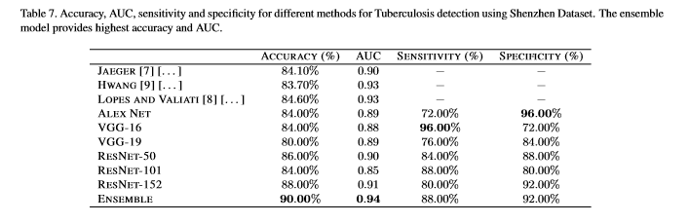
Results

